Slide 1
Pre-AP Notebook Page 2
Major Classical Era Empires
AP World History: Modern – Unit 0

Slide 2
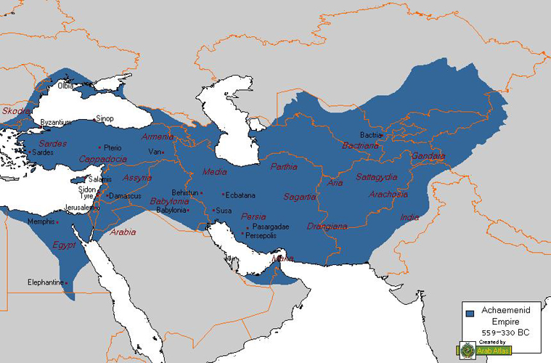
The Persian Empire
The Persian Achaemenid Empire emerged in the 6th-century BC as a military and
administrative powerhouse that established an extremely successful state system
Hailing from modern-day Iran, the Persians, led by Emperor
Cyrus the Great, formed a massive multi-ethnic empire
Reaching from Central Asia and India in the west to Egypt and
Greece in the east, the Persians ruled over more than 35 million
people—roughly half the world’s population at that time!
Aside from military success, the characteristic that set Persia
apart from its first-wave empire predecessors was that is was
organized under a single imperial central administration
Essentially, all major laws and policies came directly from the ‘god’ emperor himself; these policies were then enforced by imperially-sanctioned local governors called satraps
This was a break from the much-less successful first-wave empire practices which were
generally unsuccessful in to establishing a strong or effective centralized government

Slide 3
Persian Administration & Policy
To maintain their centralized state, the Persians setup a complex bureaucracy of administrators,
tax collectors, record keepers, translators, etc., to effectively govern their massive empire
To facilitate economic activity, travel and communication across their vast
empire, they developed standardized coins, built roads, and had a mailing service
In general, these policies were quite successful, and those who were conquered by the
Persians were often better off under Persian administration than prior to conquest
Aside from their effective administration, there were several Persian policies that
were successful in ensuring subject loyalty (or at least avoiding resentment)
Perhaps the most important non-administrative policy that encouraged
cooperation was the policy of religious and cultural toleration
As opposed to most first-wave empires, those under Persian control were often they allowed to maintain their local customs and religious, thus making it far less likely those people would rebel in the future

Slide 4
Greek City-States
Greeks were the polar opposite of Persians: they were a series of local
city-states who practiced democracy, citizen participation, & polytheism
Most city-states, such as Athens, functioned without a divine
monarch, & even those with kings, such as Sparta, still had senates
Greek city-states were known for their lack of unity, and
frequently warred with one another for power, such as
during the Peloponnesian War between Athens and Sparta
Regardless of their political differences, they held a common cultural thread through Greek medicine, science, and philosophy—all of which that would far outlast their states
Starting first in the Mediterranean, Greeks emigrated to and settled many colonies, stretching as far as modern-day Spain to the west and the Black Sea to the east
Wars with local empires, such as the Achaemenid Persians and Phoenician Carthaginians threatened their existence; however, the Greeks would either prevail or survive

Slide 5
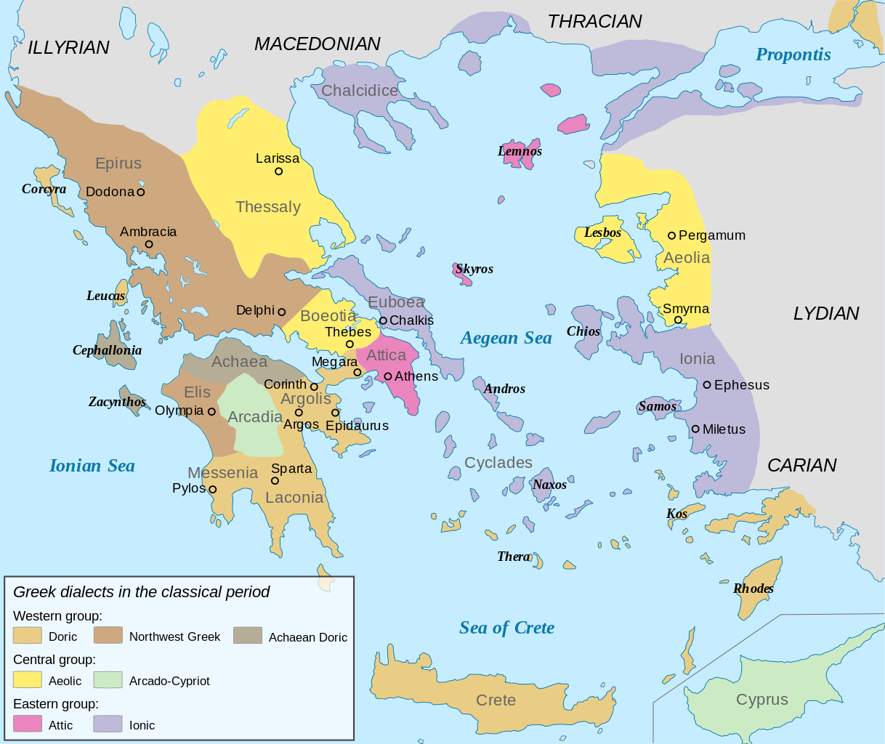
Greek City-States

Slide 6
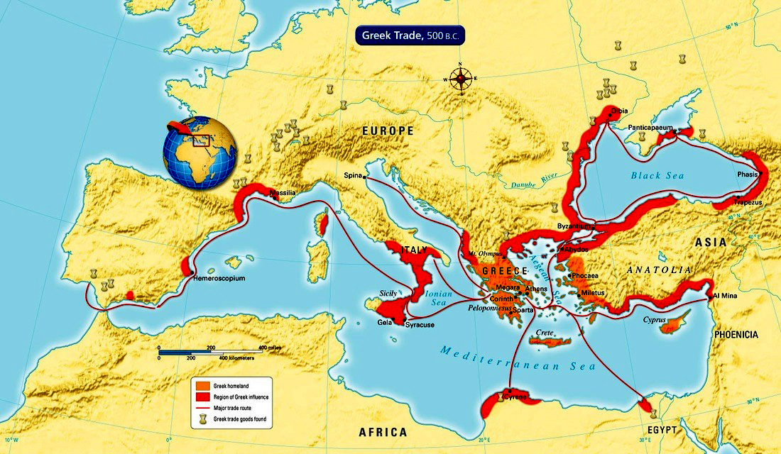
Ancient Greek Diaspora

Slide 7
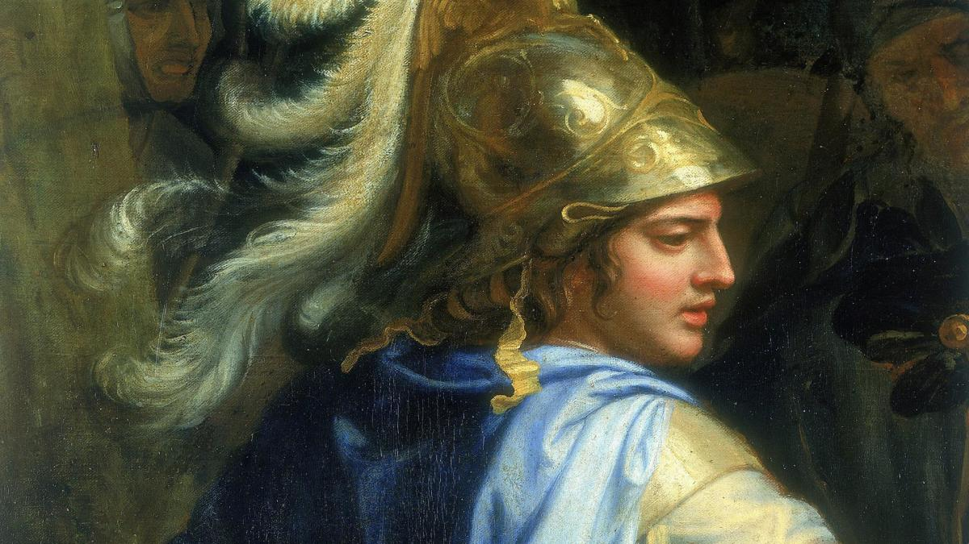
The Hellenistic Period
The story of Greece and its city-states would change once the Macedonian King Phillip II
united most of the Greek mainland following some military reforms, including the phalanx
Following Phillip’s assassination, his son Alexander the Great would continue to lead a dominant
Macedon and Greek federation to embark on one of the greatest military campaigns in world history
Alexander marched his army across Egypt, Anatolia, the Levant, and into Persia, ending the Achaemenid Empire, and continuing undefeated in battle to India and Central Asia until his death in 323 BCE
This line of conquest and Greek rule over nearly half of the world’s population ushed
in the Hellenistic Era—an era defined by Greek cultural and political dominance
While the Greek empire lasted less than three centuries, Greek culture was permanently
embedded by Alexander the Great through the construction of Greek cities and libraries that
housed Greek philosophy and science across Central Asia, North Africa, and the Middle East
Many of the main cities established by the Greeks and their settlers were named Alexandria

Slide 8
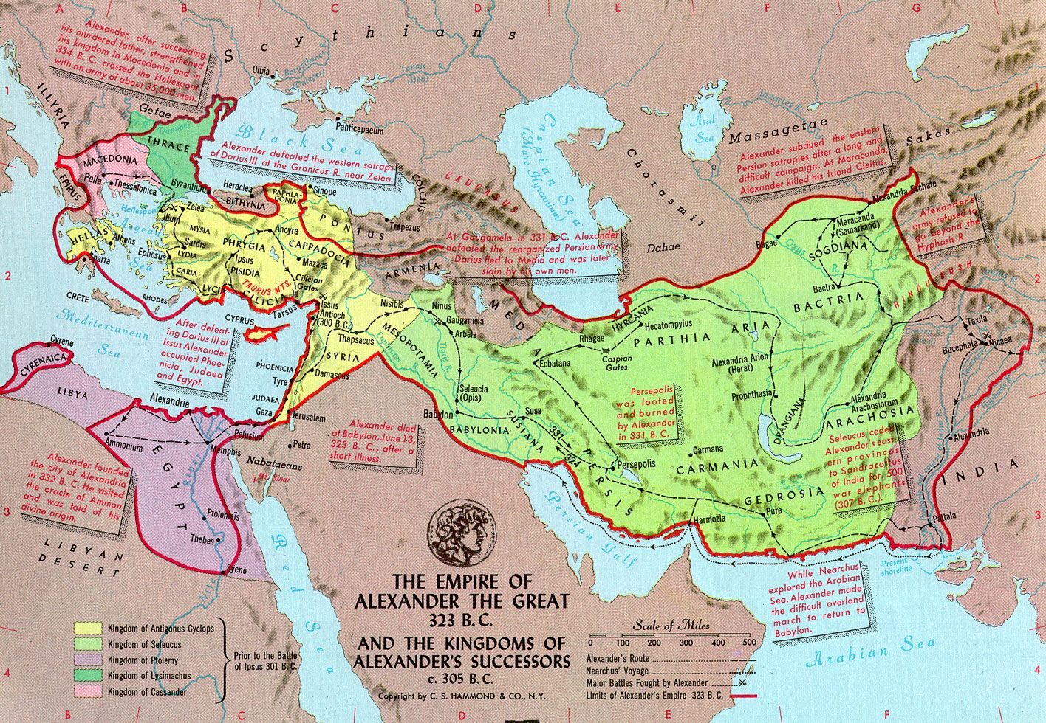
Alexander the Great’s Empire

Slide 9
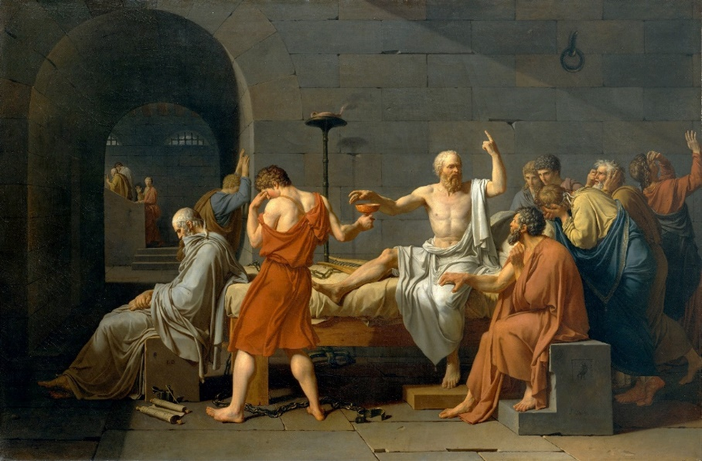
Legacy of the Greeks and Persians
The lasting legacy of Greece and Persia lays in the philosophy and state administration—both of which would impact the cultures of Greece, Persia, Rome, the Muslim world, India, Central Asia, and Western Civilization
Administratively, the Hellenistic states divided amongst Alexander’s generals following
his death adopted the centralized model of government implemented by the Persians
This governmental form formed the foundation of nearly all major states and powers following
the Persian and Greeks, including the Romans, Arabs, and other states in Africa, Asia, and Europe
Regarding knowledge, the Greek approach to knowledge, and its
emphasis on skepticism, to pursue answers through the use of logic and
observation—the early seeds of empirical scientific thought
Lastly, the writings and concepts of Socrates, Plato, Aristotle, and other
Greek philosophers would profoundly influence later Arab, Persian, Indian,
and Western mathematicians who synthesized Greek science and math to
enhance and spur their own innovations in math, science, and medicine

Slide 10
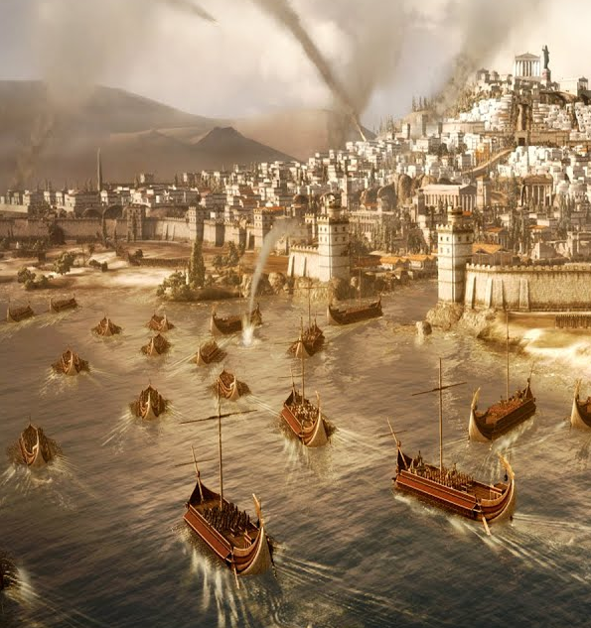
The Roman Republic
With origins as a city-state in modern-day Italy, Rome emerged as a local
military powerhouse as it conquered local Latin cities in the 500s BCE
Ruled by an elected senate, Rome then turned its gaze to areas of modern-day Spain, and
Gaul (modern-day France), before beginning its conquest of the surrounding Greek colonies
After defeating several Greek armies, the regional empires of Macedonia and Carthage
began to act against the Romans militaristically from the east and west respectively
Despite pressure from both empires, Rome was able to eventually defeat Carthage after a series
of conflicts in the Punic Wars—all in spite of several crushing defeats at the hands of Carthage
With Carthage vanquished, the Romans turned their attention to the Hellenistic states and, after several grueling campaigns, defeated their Greek opponents by 31 BCE, becoming the unquestionable rulers of the Mediterranean Sea
Despite their military dominance, the Romans would borrow heavily from Greek culture and administration, as
many contemporaries noted the similarities and structures between the previous Greek states and Rome itself

Slide 11
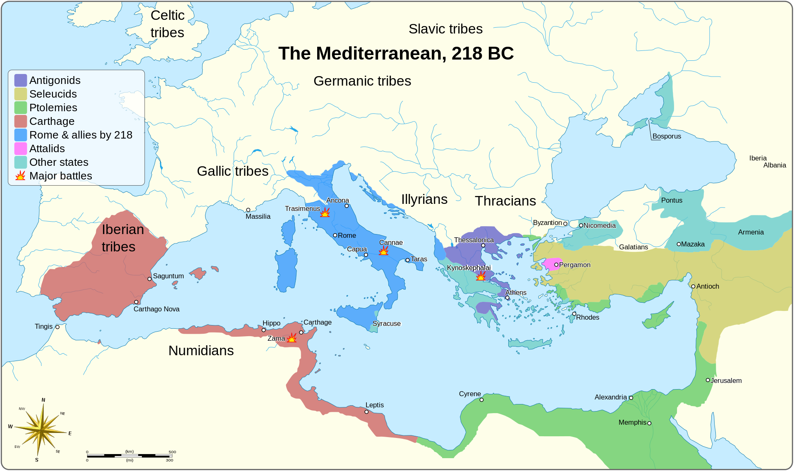
Rome, Carthage, and the Hellenistic States

Slide 12
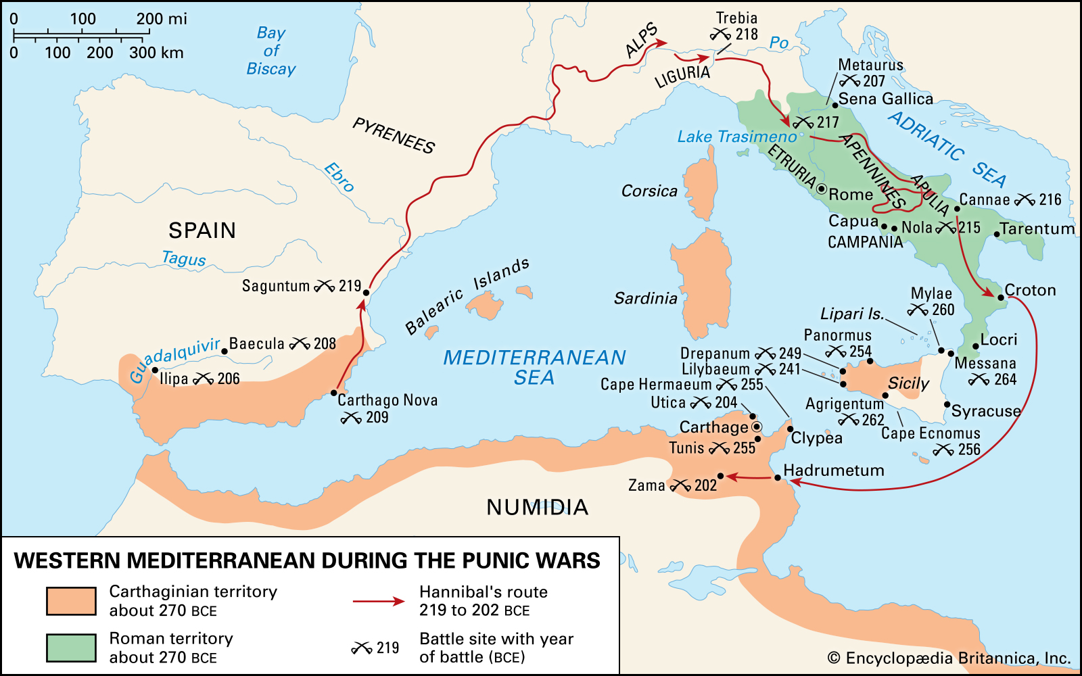
The Punic Wars

Slide 13
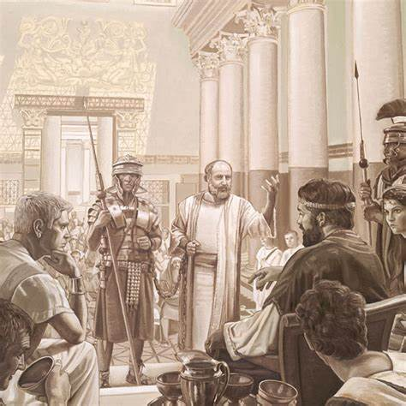
The Roman Empire
By 27 CE, however, Julius Caesar entered Rome with an army and claimed sole authority as emperor
from the Senate, thus initiating the Empire of Rome, and continuing its tradition of conquest
After several rounds of military reforms, the Roman Army’s size grew substantially
with enticing were rewards, such as land grants from conquered areas upon retirement
Large estates, tax breaks, and political positions were given to loyal upper-class elites
Also, like the Persians, Rome established a centralized government and bureaucracy,
complete with local governors, translators, record keepers, roads, and a common currency
Unique to the Romans, however, was the policy of Roman Citizenship which offered
full protections and privileges to those it conquered with no strings attached
For those who caused trouble or rebellion, however, Roman reprisal was swift and brutal
Rome grew so large, in fact, the empire split administration in half by establishing a Western and
Eastern Roman Empire; while the Western Empire would fall in 485 CE to Germanic invaders, the East would continue under Greek rule until 1453 CE, known today by historians as the Byzantine Empire

Slide 14
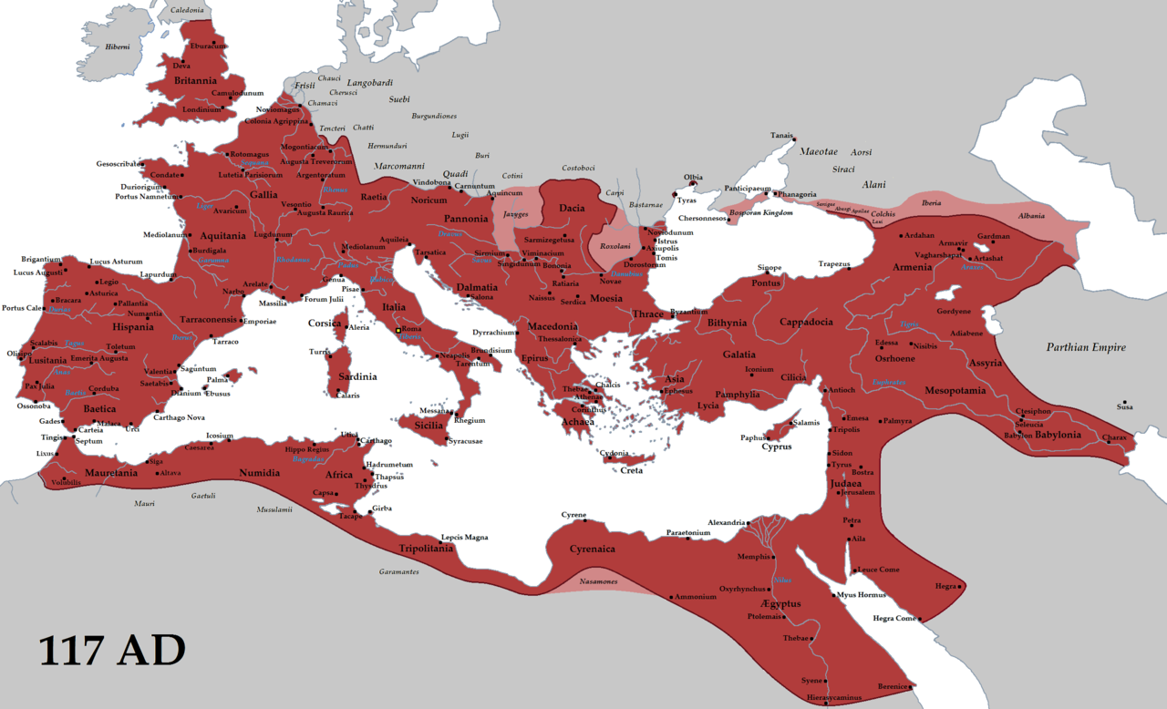
Maximum Extent of the Roman Empire

Slide 15
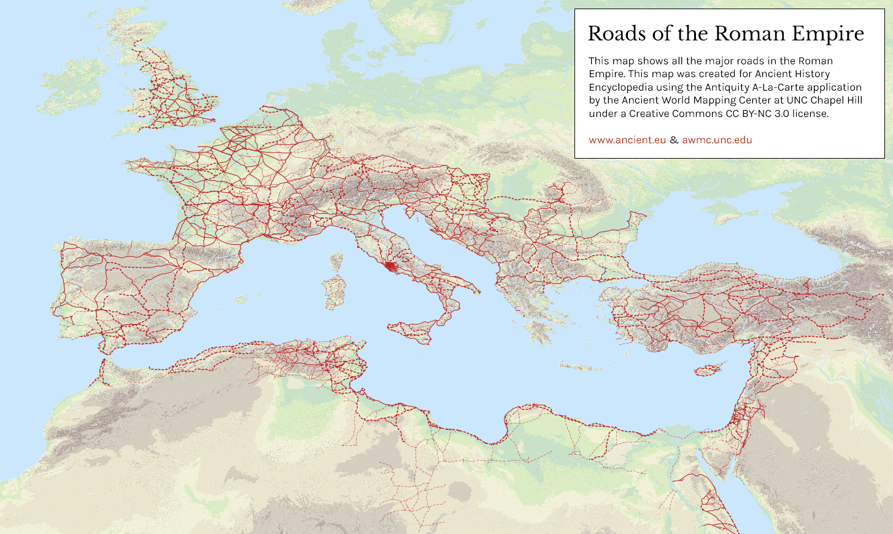

Slide 16
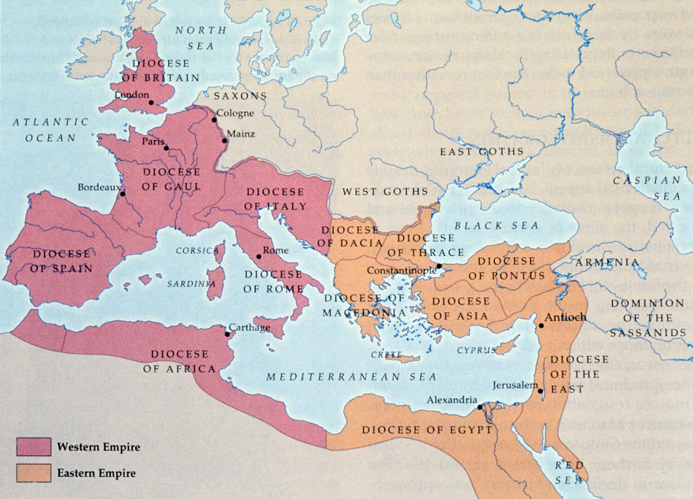
Western and Eastern Roman Empires

Slide 17
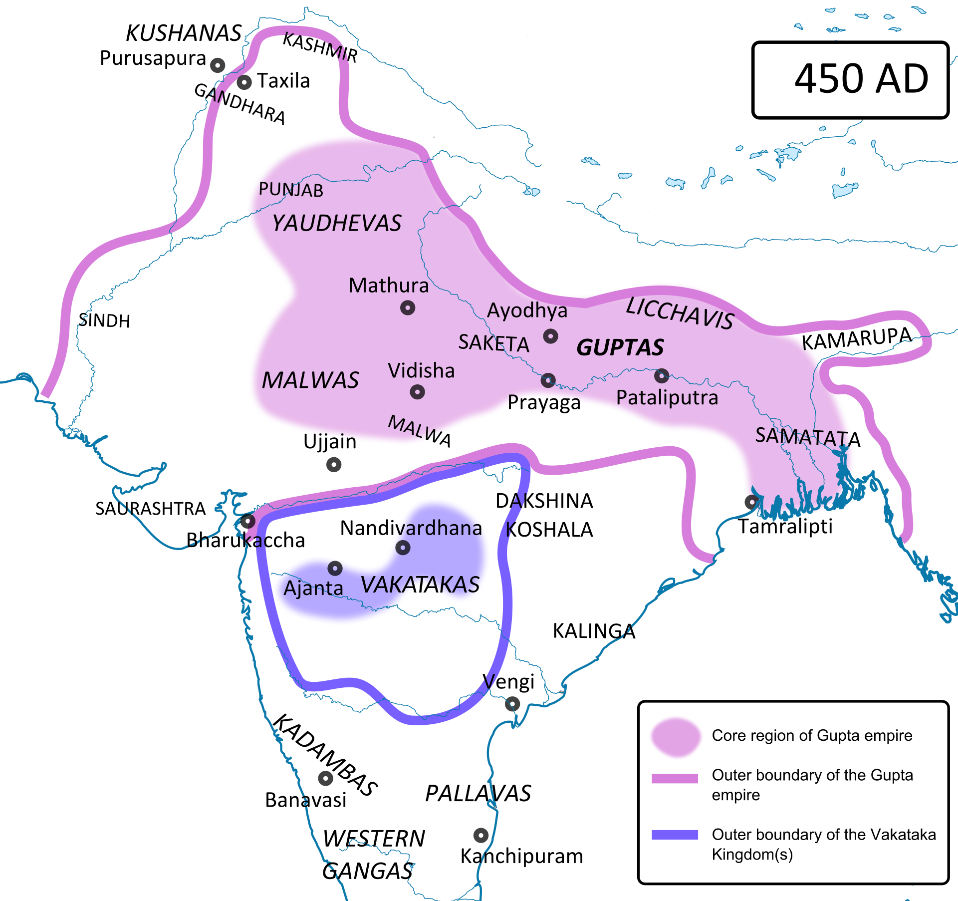
The Golden Age of India
Following a period of feuding local Indian kingdoms and Kushan and Persian invaders from Central Asia and Iran, a large portion of the Indian subcontinent was once again centralized in 3rd century CE
Known as the Gupta Empire (350-543 CE), the empire, started by king Sri Gupta,
ushered in a period referred to historians as the ‘Golden Age of India’
With a centralized imperial state system, political and economic stability
allowed trade, knowledge, and prosperity to grow rapidly in the Gupta Empire
During the Gupta Empire, many of the definitive Indian cultural icons were
developed, as Indian art, poetry, science, mathematics, and architecture flourished
Innovations such as the modern algebraic system, number system, concept of zero,
theories of a round Earth that rotates on its axis, and iconic games like chess emerged
While the empire itself would end due to internal strike and Hunnic invaders from Central Asia,
it left a lasting legacy on Indian and world history that extended well beyond its own time

Slide 18
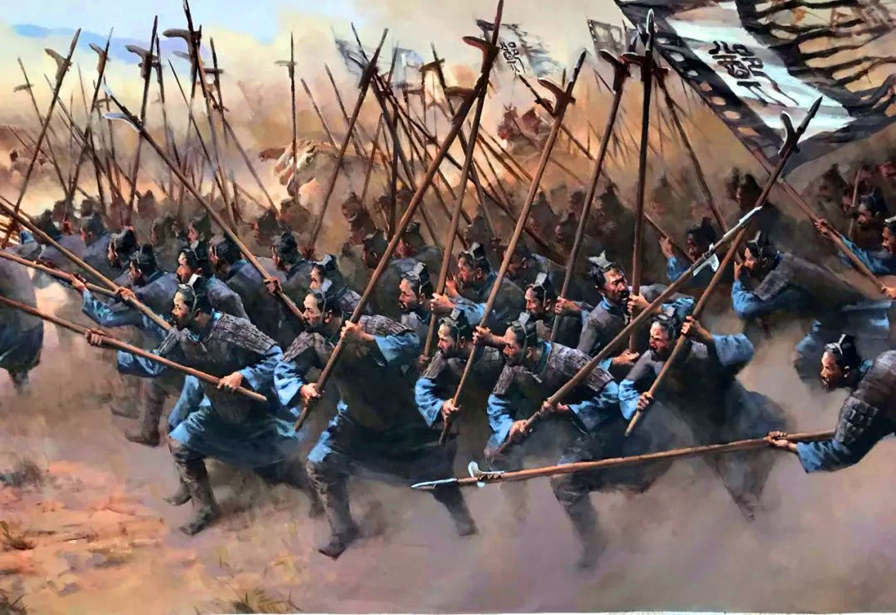
China: The Warring States Period
Centuries of Chinese unity and relative peace under the Shang Dynasty and Zhou Dynasty
were shattered in roughly 475 BCE as the weakening Zhou Dynasty succumbed to the Warring
States Period, as seven smaller states began to war for power and recognition until 221 BCE
During this era, many rulers justified their efforts by claiming the Zhou had lost the Mandate, and, for
more than two centuries, inhabitants of China dealt with constant war, death, famine, and instability
In response to the lack of traditional unity, many reformers began
to contemplate new systems of thought to philosophy and law
One such system developed in the Chinese state of Qin as an
alternative to previous religious models of thinking and behavior
Known as Legalism, the system emphasized the existence of a
strong state built on moral law, strict secular laws and punishments,
as well as administrative positions based on individual merit

Slide 19
The Qin Dynasty
The adoption of Legalism allowed Shi Huangdi of Qin to grow in efficiency and power, thus tipping the scales
in its favor and eventually defeating the other kingdoms and ending the Warring States Period in 221 BCE
A skilled administrator, and adherent of the Legalist system, Shi Huangdi setup an effective
central bureaucracy, public roads, a common currency, and established a formal written language
With no known record of contact with the western empires of ancient Persia, Greece, or Rome, the
Qin Dynasty had independently created the first successful large-scale centralize empire in East Asia
Centered in the imperial capital city of Chang’an, the Qin Dynasty
established a foundational state system for later Chinese dynasties,
and successfully unified the regional kingdoms into an empire
Shi Huangdi was also able to push back the traditional enemy of China: the
pastoralist Xiongnu Confederacy to the north, as well as mobilizing peasants
to erect the first sections of what is now known as the Great Wall of China
The Qin Dynasty was, however, known for its hard-handedness regarding state policy, as well as the suppression of opposing philosophical ideals; the dynasty was weakened substantially following the death of Shi Huangdi

Slide 20
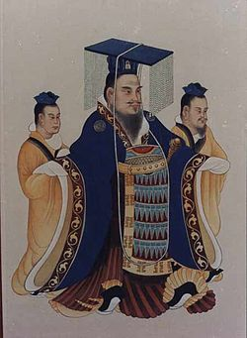
The Han Dynasty
Despite suppression by the hard-handed Qin Dynasty, Confucianism survived the Qin’s reign and would eventually be adopted by the second imperial dynasty of China: the Han Dynasty
The Han Dynasty (202 BCE – 220 CE) emerged after the establishment of the rebel leader
Liu Bang defeated his rivals and controlled imperial China after the fall of the Qin Dynasty
The Han issued in a Golden Age of imperial Chinese history, expanding territorially, as well as advancing Chinese culture, written language, poetry, art, medicine, technology, and philosophy
The Han state expanded trade, connecting, indirectly, with the Western world
and the Roman Empire, developing the world’s first trade between the two realms
through a network of trade routes known collectively as the Silk Roads of Asia
Along with forming the name of China’s primary ethnic group, the Han officially adopted Confucianism as the official state philosophy under Emperor Wu of Han in the 1st century BCE
Despite defeating and vassalizing a renewed Xiongnu Confederacy in the 2nd
century BCE, the Han, repeated steppe raiding, administrative strife, and religiously-
inspired rebellions would ultimately lead to the fall of the Han Dynasty by 220 CE

