Slide 1
Pre-AP Notebook Page 4
Major Classical Trade Routes
AP World History: Modern – Unit 0

Slide 2
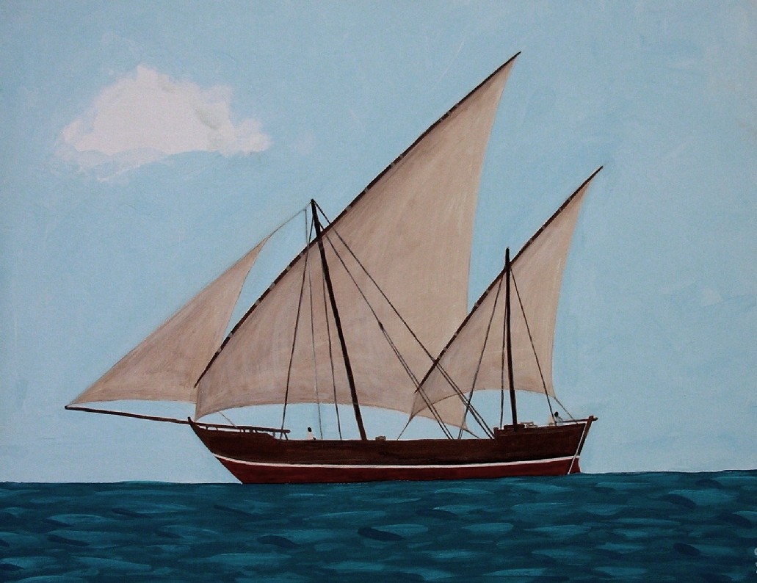
Indian Ocean Trade
By 500 CE, trade had largely opened up in the Indian Ocean, connecting the Middle East, Persia, India, Southeast Asia, China, and East Africa
This trade was enabled by improved shipbuilding (lateen sails),
navigation, and knowledge of the monsoon winds
These monsoon winds were directioned predictably in
the spring, summer, and winter, allowing safer, faster trade
The sea truly connected these areas for the first time,
and allowed the spread of cultures, goods, and religion

Slide 3
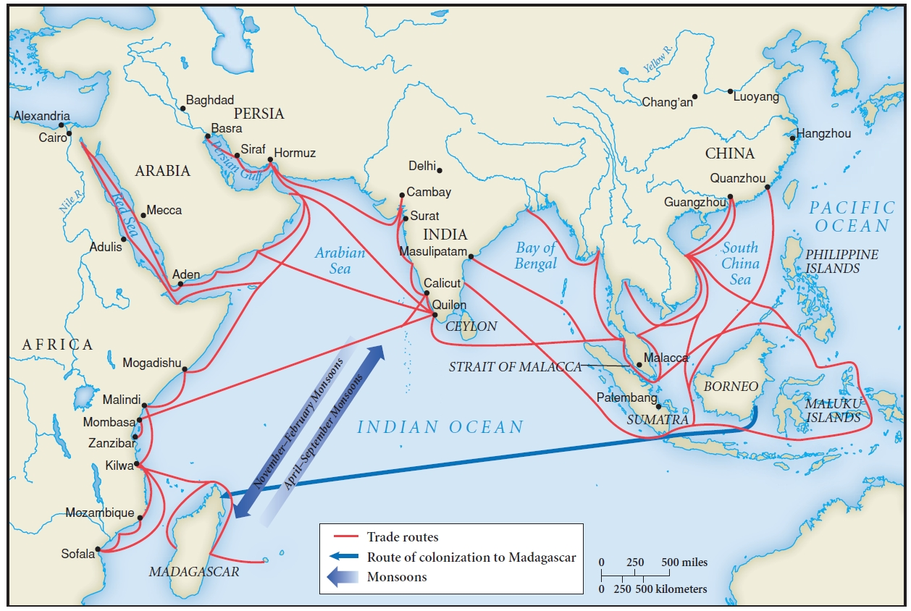

Slide 4
Silk Road Trade
Trade between the Roman and Chinese Empires was initially brokered by the pastoral people of Central Asia
This trade route (mostly luxury goods) connected the world of Rome, Persia, India, and China
Tech such as yokes and saddles enhanced trade and enabled the use of camels, horses, and oxen
These same concepts enabled trade and connection with West and East Africa via the Sub-Saharan Trade Network

