Slide 1
Pre-AP Notebook Page 1
Major Classical Religions
AP World History: Modern – Unit 0

Slide 2
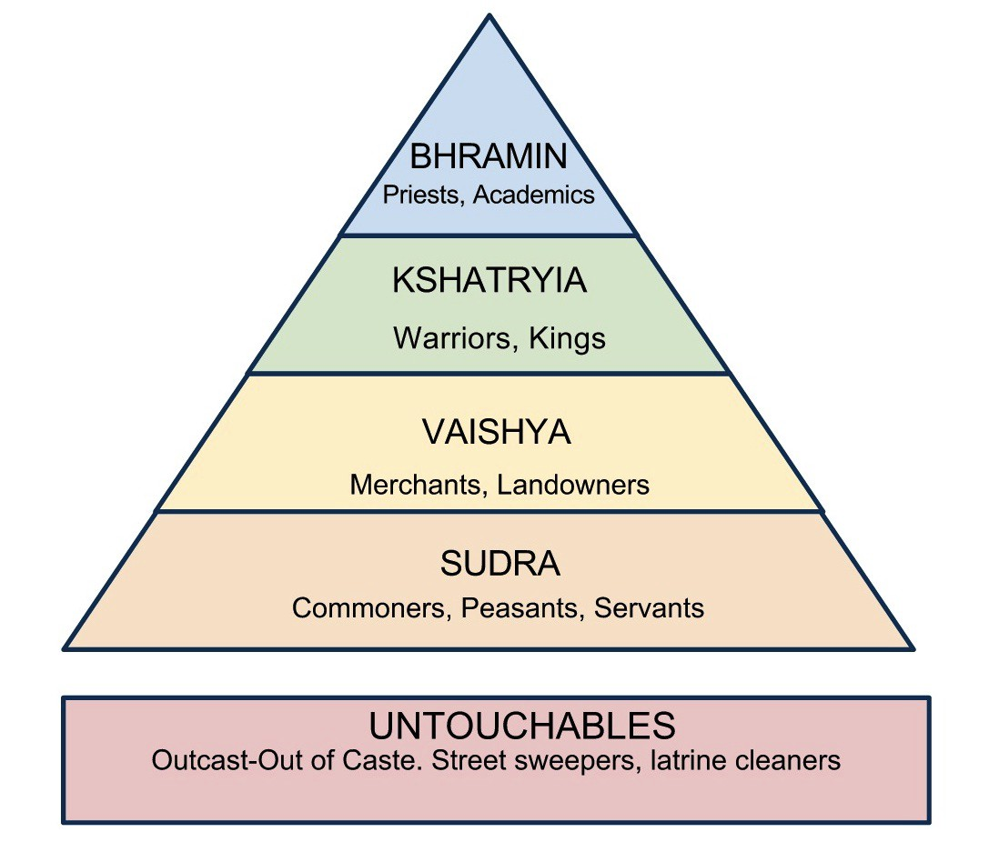
Hinduism in The Indian Subcontinent
In India, Indo-Aryan invaders from the Eurasia steppe chased out the Indus civilizations, bringing
their social and religious systems through the Vedic religions between 2000 and 1500 BCE
These oral beliefs were eventually codified into writing know as the Vedas by 700 BCE, and the ensuing
belief system would become known as Hinduism—possibly the oldest organized religion in the world
Hinduism essentially believes in a cycle of rebirth and reincarnation with the
overall goal of transcending human life and uniting with Brahma—the universe
To do this, one would live their life fulfilling their caste task, even if they
were bad at it; the fulfillment of their caste duty was referred to as dharma
If they fulfilled their task throughout their lifetime, they received good karma and
were reborn in the next life as a higher caste until finally unifying with Brahma
As a consequence of these beliefs, a rigid socio-religious system emerged
in the Indian subcontinent that would later become known as the caste system

Slide 3
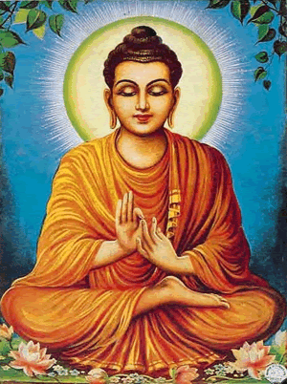
Buddhism and the Maurya Empire
While providing a stable model for society, many were unhappy with the rigid
caste system that offered no lifetime opportunity for caste advancement or equality
As a response to the rigid and fixed castes of Hinduism in which one was locked hierarchically,
Siddhartha Gautama in northeast India formulated a rival belief system known today as Buddhism
In Buddhism, life is defined by one’s suffering; to Buddhists, we suffer due to our desire
and greed for material wealth and social advancement, thus causing us anxiety and pain
As a remedy, Buddhism suggests ridding yourself of such desires by leading
a simple, meditated life in which any person could achieve nirvana—transcendence
from greed and material desires, and an ending of suffering in the cycle of rebirth
Buddhism was unappealing to most rulers as it taught against their lifestyles and power, however,
it would spread throughout South, Central, Southeast, and eventually East Asia in the coming centuries
While short-lived in India itself, it was able to gain prominence and spread under the centralized Mauryan
Empire (322 BC – 187 BC) once its beliefs had been adopted by the Maura Emperor Ashoka the Great
Ashoka encouraged its spread through state policy, the building of Buddhist stupa,
and the support of Buddhist missionaries, monks, and merchants throughout the region

Slide 4
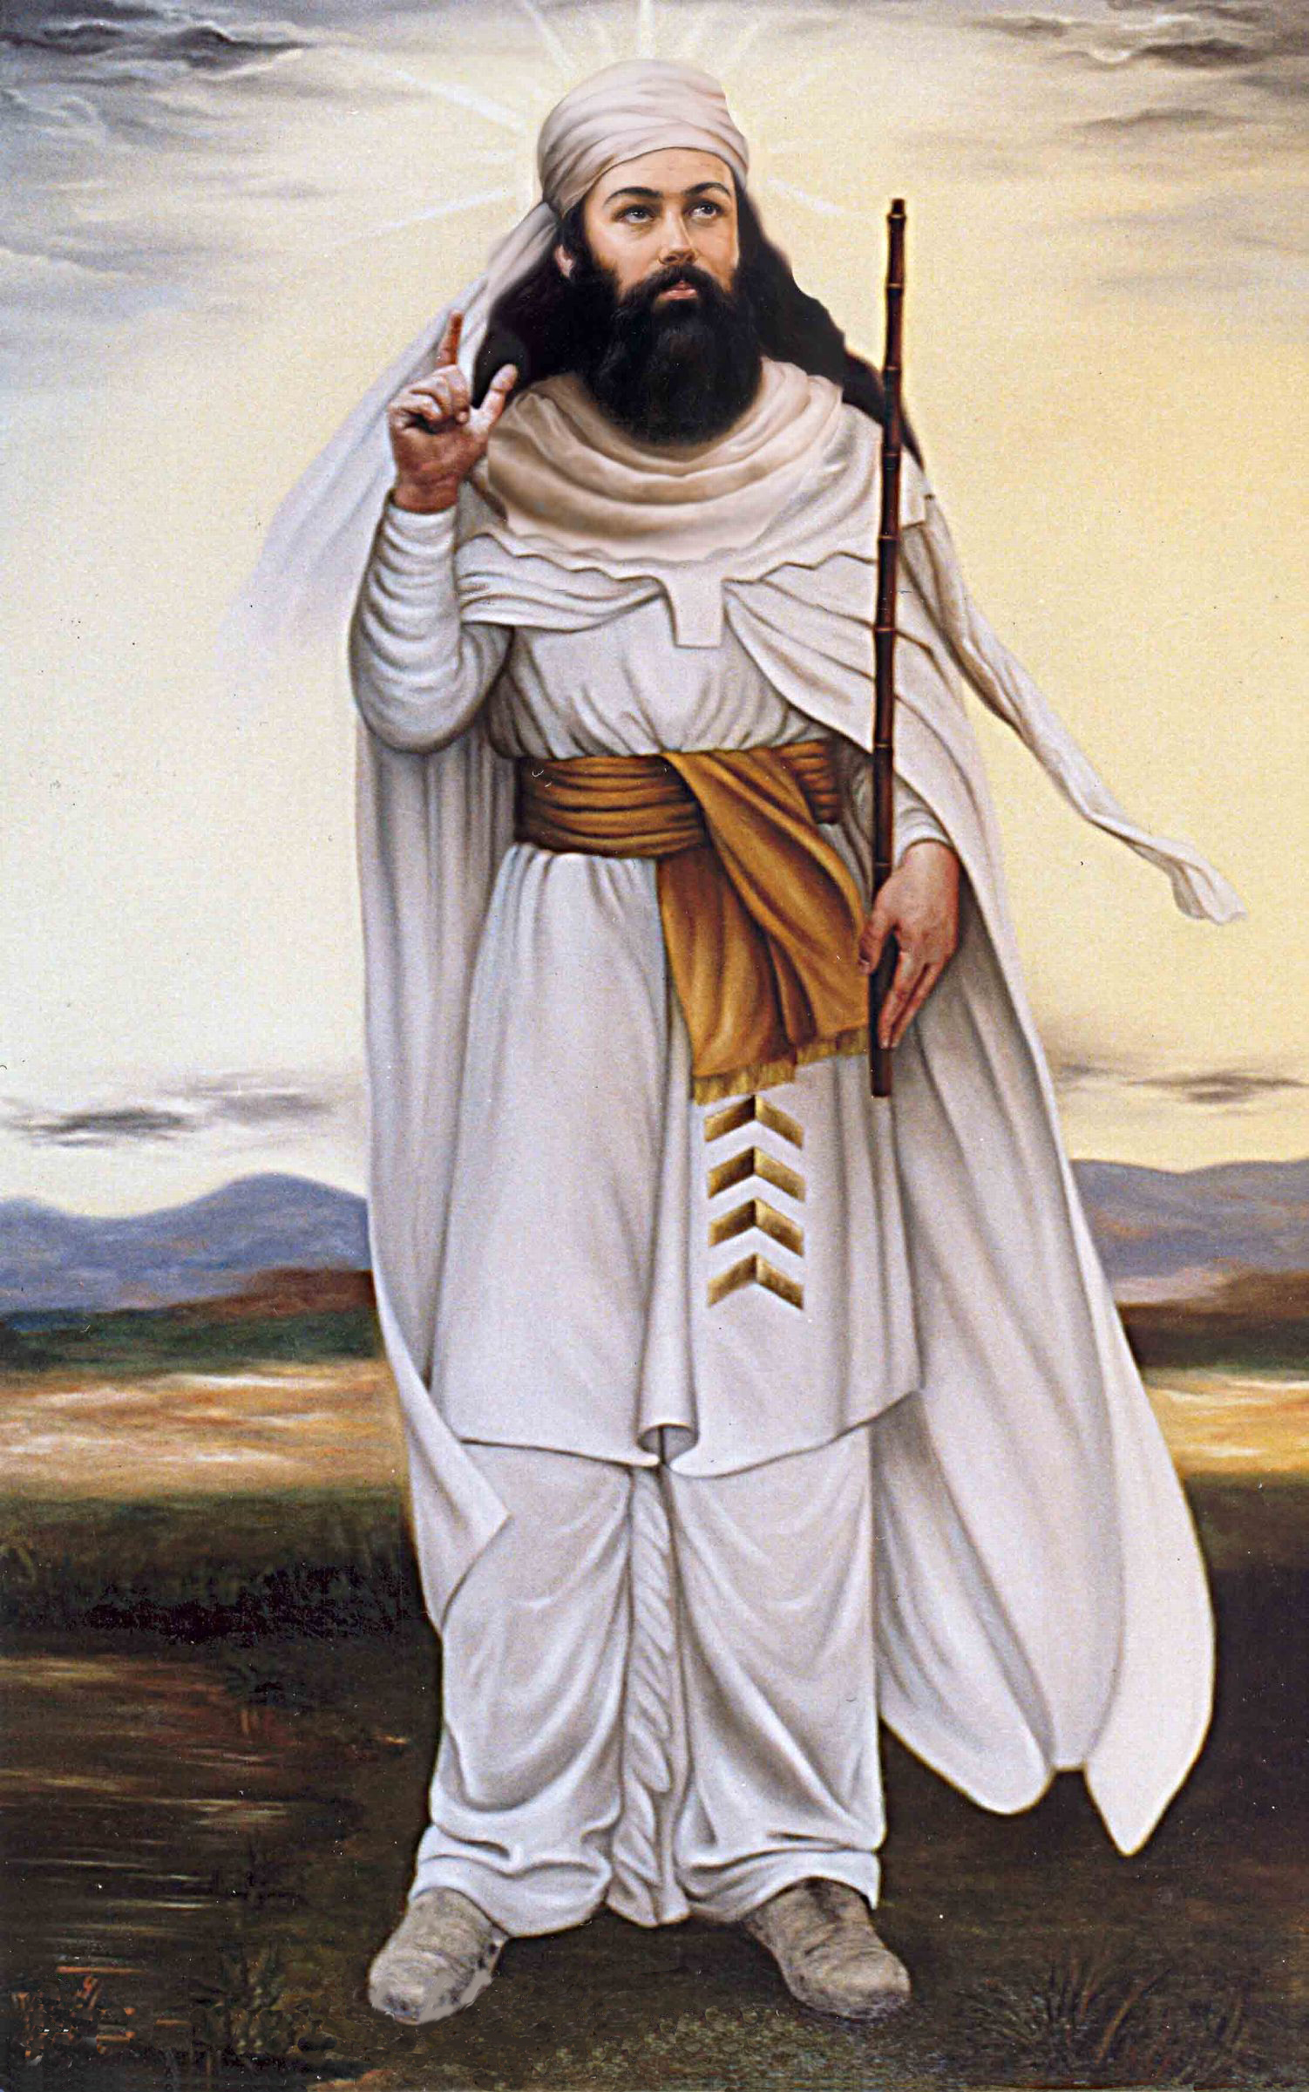
Zoroastrianism
Throughout most of human history, religions had been polytheistic—predicated on the existence of multiple gods
With roots as far back as perhaps the 2nd millennia BCE, the teachings of the
Iranian-speaking Zoroaster enter written history in the 5th-century BCE
Known as Zoroastrianism, the religion that came to dominate Persia for more than
1200 years was a monotheistic religion-one that believed in a single, all-powerful deity
Zoroastrianism would set several world-first precedents for later large-scale,
organized religions in the region, including the following themes and ideals:
Monotheism (Ahura Mazda as the supreme creator)
The concept of a universal ‘Good’ and ‘Evil’
A universal battle between the forces of Good and Evil
Human free will and the ability to orient towards Good or Evil
The coming of a future messiah to tip the universal fight in the favor of the ‘Good’
Zoroaster taught that humans should pursue a life oriented towards being
‘good’ for the sake of Good, spiritual gender equality & duty, and charity
The religion itself was profoundly influential on Persian emperors throughout the centuries, and is largely
attributed to Persian pursuits of bettering their Empire and its services for the sake of all peoples within it

Slide 5
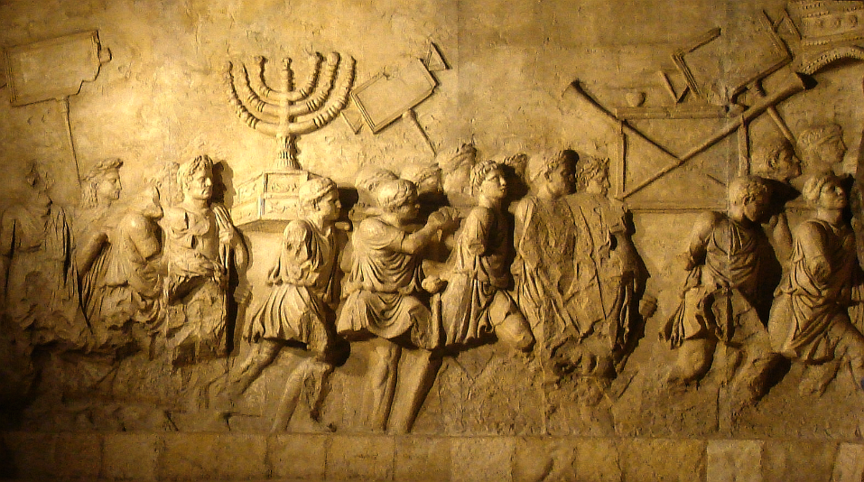
Second-Temple Judaism
Zoroastrianism would profoundly influence the previously-existent Hebrew religion known as Judaism
With oral roots dating back further, Judaism itself has written roots dating
back to the 6th-century BCE, and whose beliefs are codified today in the Tanakh
Prior to its exposure to the Persian Empire and Zoroastrianism, Judaism contained elements
of polytheism, and other regional religious characteristics of the Mesopotamian region
Following their exile to Babylon and return to their traditional kingdom of Israel and
Judah at the hands of the Persian Empire, Judaism shifted to a more Zoroastrian model
Known as Second-Temple Judaism (named for its shift in theology following Cyrus the Great’s funding of a second temple in Jerusalem), the Jewish faith more or less adopted the following features:
Monotheism (the emphasis on Yahweh as the supreme creator)
An eternal battle between Good and Evil
The ability or free will to choose to live oriented towards Good or Evil
The promise of a future messiah to tip the battle in the favor of the Good

Slide 6
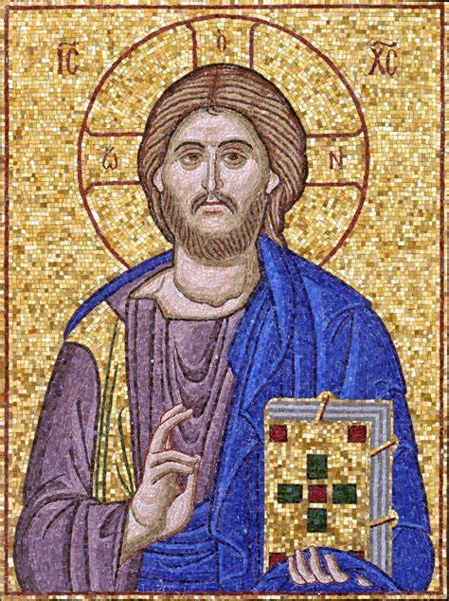
Christianity
While still a major religion with more than 14 million worldwide adherents,
Judaism laid the foundation of another influential world religion: Christianity
The teachings of Christianity began around 20-33 CE when disciples in Israel
began cataloging & following the miracles and teachings of Jesus of Nazareth
According to Christianity, Jesus of Nazareth was the incarnation of the messiah
promised in the Jewish faith (although most had hoped he was a military savior)
The promise of a messiah was particularly appealing to many of the Jewish
people at the time who were currently occupied by the Roman Empire
Noting the popular appeal of Jesus of Nazareth as a messiah, and possibly figure
to lead a revolt, the Roman Empire quickly opposed Christianity and its adherents
While Rome attempted to stop Christianity, missionaries such as Paul of Tarsus engaged in extensive missionary work and traveling to keep the religion alive despite Roman persecution
As such, missionaries and merchants continued to spread the young religion throughout
the Roman empire into the Middle East, Northern Africa, Central Asia, and Europe

Slide 7
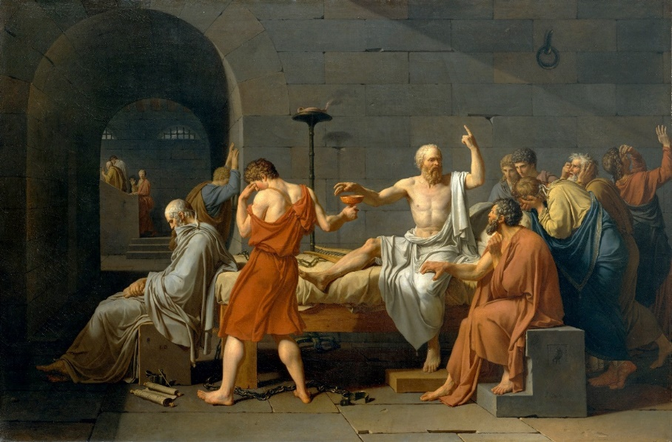
Legacy of the Greeks and Persians
The lasting legacy of Greece and Persia lays in the philosophy and state administration—both of which would
impact the cultures of Greece, Persia, Rome, the Muslim world, India, Central Asia, and Western Civilization
Administratively, the Hellenistic states divided amongst Alexander’s generals following
his death adopted the centralized model of government implemented by the Persians
This governmental form formed the foundation of nearly all major states and powers following
the Persian and Greeks, including the Romans, Arabs, and other states in Africa, Asia, and Europe
Regarding knowledge, the Greek approach to knowledge, and its
emphasis on skepticism, to pursue answers through the use of logic and
observation—the early seeds of empirical scientific thought
Lastly, the writings and concepts of Socrates, Plato, Aristotle, and other
Greek philosophers would profoundly influence later Arab, Persian, Indian,
and Western mathematicians who synthesized Greek science and math to
enhance and spur their own innovations in math, science, and medicine

Slide 8
Confucianism
Among the list of philosophies and ideals suppressed by the short-lived Qin Dynasty was
the increasingly-popular teachings of the Chinese philosopher Confucius (551-479 BCE)
In response to the chaos of China Confucius worked to develop a solution to the disorder from the
warring states and promote unity under the state; this philosophy is known today as Confucianism
Codified in a series of writings known as the Analects, Confucianism laid out three fundamental levels to maintain social harmony that transitioned first from the individual, to the family, and finally to the state
Individually, Confucianism expects that people pursue education, honest, integrity, morality,
and, perhaps most importantly, remain loyal to their duties and hierarchical superiors
With these personal guidelines, they were to unquestionably adhere
to the rigid patriarchal family; the [male] leaders were then, in tern,
expected to respect, protect, and support their family members
These individual and family models were intended to emulate and
prime members of society to maintain social harmony, and honor
the patriarchal authority of the emperor and his administration

